Slide 1
Computer Graphics
EG678EX
Graphics Software
Prepared By:KKJ

Slide 2
Graphics Software
Two categories
  General Purpose programming package
    Provides extensive sets of graphics functions that can be used in high level programming languages such as C or FORTRAN
    Designed for programmers
    Example: GL (Graphics Library)
    Basic functions
      to generate picture components as: straight lines, polygons, circles etc
      Setting intensities, view selections and transformations
  Special purpose application package
    Designed for non-programmers
    Users need not to know how graphics operations work
    Interface to graphics routine allows users to communicate with programs in their own terms
    Example: artist’s painting programs and various business, medical and CAD systems
Prepared By:KKJ

Slide 3
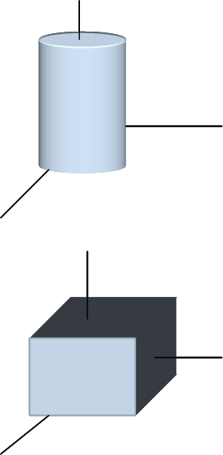
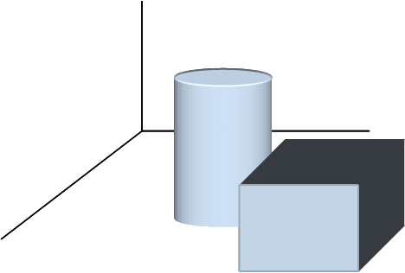
General Purpose programming package
Coordinate representations: most graphics packages use cartesian coordinate specifications
  Modeling coordinates: individual objects in a scene are described at individual coordinate reference frame called modeling coordinates
  world coordinates
  Device coordinates and normalized device coordinates
Graphics Functions: a general purpose packages provides various functions
  Categorized as output, input, attributes, transformations, viewing or general controls ( clearing a display screen or initializing parameters)
MC
WC
Prepared By:KKJ

Slide 4
Software Standards
Portability of graphics software is primary goal
Standards help to fulfill this goal
Graphical Kernel System (GKS): first standard by International Standards Organization (ISO) and various organizations including American National Standards Institute (ANSI)
  GKS: for 2D and 3D graphics
Programmer’s Hierarchical Interactive Graphics Standard (PHIGS)
  Extension of GKS
  Increased capability of object modeling, color specifications, surface rendering and picture manipulaions
  PHIGS+ : extension of PHIGS for 3D surface shading that PHIG is not capable
Computer Graphics Interface (CGI)
  For graphics interface to output device
Computer Graphics Metafile (CGM)
  For archiving (archive = collection of pictures or documents) and transporting pictures
Prepared By:KKJ

Slide 5
Project Management and Program Debugging
Prepared By:KKJ

Slide 6
Project Management
Essential part of software engineering
Software management is distinct from other engineering management in as:
  Intangibility of product:
    ship engineering
      product progress is visible
    Software Engineering
      Product progress is not visible rather than to rely on documentation
  Lack of standard software processes
    In other engineering there are standards and impact of particular process could be predicted but in case of software engineering, process varies from organization to organization and difficult to predict the impact of particular process
  Uniqueness of the project
    Large software projects are different from previous projects
    Lessons from previous project may not be transferrable
Prepared By:KKJ

Slide 7
Project Management Activities
Most General activities
  Proposal writing
  Project planning and scheduling
    Iterative process and continues throughout the project
    More information becomes available → plans and schedules must be revised
  Project cost estimation
    Budgeting
    Optimizing the project cost by time management and human resource management
  Project monitoring and reviews
  Personnel selection and evaluation
    Skilled staff → deliverable outcome
  Report writing and presentations
    Managers responsibility to present the progress reports both to the clients and contractors
  Risk Management
    Project Risk → affected by project schedule or resources
    Product Risk → quality and performance
    Business risks → affects the organization developing or procuring the software
Prepared By:KKJ

Slide 8
Program Debugging
Process of finding and reducing the number of bugs
General procedures
  Reproduce the problem → reproduce the problem in while monitoring the output
    Simplify the input after bug is produce to debug
  Use debugger to track the origin of the problem after test case is simplified
  Tracing is other alternative
    Simple print statement is also a tracing
  Remote debugging
    Program runs on different machine than debugger
    Debugger logs on to remote machine and controls the execution of program to identify the origin of problem
Prepared By:KKJ

